Slide 1

Development Webserver
Cory House
@housecor reactjsconsulting.com
Notes:
If you’re working in JavaScript, chances are you’ll want to run at least some of your code in a browser.

Slide 2
Review Development webserver options
Configure a Dev Webserver
Services for sharing your work
The plan
Notes:
So in this short module, let’s quickly consider a few interesting options for development webservers.
We’ll configure our webserver so it’s automatically started as part of our development process and opens our application so we can review our results immediately every time we hit save.
And what if we want to quickly share our work in process with others? We’ll look at a few useful services for making that quick and easy.
Alright, let’s get started by shopping for a development webserver.

Slide 3

Development Webservers
http-server
Express
Webpack dev server
Browsersync
Notes:
There are many production grade webservers out there such as IIS, Apache, Tomcat, and Nginx. But for development, I recommend using a webserver that’s focused on local development. Here are 4 webservers to consider for JavaScript development. Let’s discuss the merits of each.

Slide 4
http-server
Ultra-simple
Single command serves current directory
Notes:
The absolute simplest way I’ve found to get this done is an npm package called http-server.
After installing it, you simply type http-server in the directory you want to serve and it fires up a lightweight webserver that serves the current directory as the web root. It really can’t get simpler than this. And it’s not just great because it’s super lightweight and requires no configuration. As you can see, it has an amazing logo. I mean, if the idea of a strapping a rocket to a turtle doesn’t move you, check your pulse! That turtle means business. Respect.

Slide 5
Express
Comprehensive
Highly configurable
Production grade
Can run it everywhere
Express alternatives
Notes:
You’ve likely heard of Express. While it’s still pretty lightweight, it’s much more full-featured than the other options we just discussed and it’s highly configurable. And unlike http server and live-server, it’s not just for static files. You can serve up complex APIs via Node using Express as well.
The advantage to choosing Express for your dev server is you can use it in production as well.
So if you choose express as your development webserver, you have the advantage of running the same webserver in all places. This allows you to create a common configuration and use it in all environments. If you’re building APIs in Node, then this is a big win that makes using Express as your development server an easy choice.
And while we’re talking about Express, it’s worth considering Express competitors like Koa and Hapi. Express is the most popular and has the largest community, but Koa is interesting because of its strong embrace of ES6 generators, and Hapi was created by Wal-mart labs and boasts a compelling configuration model. If you’re doing server-side work in Node, these three are popular options worth carefully considering. But if you choose any of these, you’re likely to use these in production as well. If you have an existing API layer using non-JavaScript technologies like Ruby, Python, .NET, or Java, then these are likely overkill for your development server.

Slide 6
Webpack Dev Server
Built in to Webpack
Serves from memory
Includes hot reloading
Notes:
And if you choose a more comprehensive bundler like Webpack, you can enjoy its built in webserver. The advantage to this option is it avoids pulling in another dependency, and it’s very fast to load changes because it doesn’t require generating any physical files. Webpack serves your app from memory.
And like Budo, it also supports hot reloading.
Again, we’ll discuss bundlers more in an upcoming module, but it’s worth noting that if you choose Browserify or Webpack as your bundler, there are popular dev server options for each.

Slide 7

Browsersync
Dedicated IP for sharing work on LAN
All interactions remain in sync!
Great for cross-device testing
Integrates with Webpack, Browserify, Gulp
Notes:
Finally, you should also consider Browsersync. Browsersync is a free web server that has a two really compelling features: First, Browsersync automatically sets up a dedicated IP address on your local network so that you, or anyone who can hit the IP on your local area network can see your app.
The second feature is really special. You can hit that same IP on multiple devices and all the devices will remain in sync. (cut to demo) Here I’m running the same application from two different browsers, but my interactions remain in sync because Browsersync is running behind the scenes.
This is super useful for browser and device testing so you can assure your work is rendering properly on a variety of devices. I’ve seen people create a wall of devices and then use Browsersync to regularly get feedback that the design is working across a variety of screen sizes and platforms.
You can even use Browsersync along with Webpack, Browserify, Gulp and more. (cut to recipes at https://github.com/BrowserSync/recipes). There are detailed examples of using browsersync with a variety of setups published here in the docs under recipes. So you can think of Browsersync as a powerful and free development webserver, or a way to augment your existing development webserver with additional features.

Slide 8
Development Webservers
http-server
Express
Webpack dev server
Browsersync
Notes:
So these are 4 development web servers to consider.
One final note, to clarify, with the exception of Express, these webservers are not for use in production. They’re merely for hosting your application for development on your local machine. We’ll discuss production deployment in a later module.

Slide 9
Set Up Development Webserver
Notes:
For this course, let’s use Express as our development webserver because it’s powerful, highly configurable, and extremely popular.
-------------
Also, can set up express with browsersync like this: https://github.com/voorhoede/front-end-tooling-recipes/blob/master/express-with-nodemon-browsersync/index.js

Slide 10
Sharing Work-in-progress
Notes:
And while we’re on the topic of webserver, there’s a closely related topic which involves sharing work-in-progress so clients can review your progress. As I mentioned, Browsersync is a handy way to share your work with co-workers. But Browsersync doesn’t expose a public IP for testing outside of your local network. So what if you want to quickly share your work on the public web so your client can review your work-in-progress? This used to be a hassle, but these days it’s shockingly easy.

Slide 11
Uh, why wouldn’t I just put my work on AWS, Azure, etc?
- You, my curious viewer
Notes:
Now I’m about to show you some novel services that you might not have heard of. But you might be thinking, why wouldn’t I just put my work on a traditional cloud provider like AWS, Azure, etc. The answer is the services I’m about to show you make it hilariously easy to share your work without having to configure a cloud provider or pay for hosting of any kind. So if money and time are important to you, keep listening. I thought that would get your attention.

Slide 12


Sharing Work-in-progress
localtunnel
ngrok
Surge
Vercel
Notes:
Here are some ultra-low friction options for easily showing your customers your work along the way:
Localtunnel, ngrok, surge, and Vercel. Let’s talk about each of these in more detail.

Slide 13
localtunnel
Easily share work on your local machine
Setup:
1. npm install localtunnel -g
2. Start your app
3. lt --port 3000
Notes:
The lowest friction way I’ve found is localtunnel. Localtunnel offers an elegant way to expose your localhost via a public URL. It punches a hole in your firewall so your local machine can operate as a webserver. The nice thing about localtunnel is how easy it is to get started. You install the localtunnel npm package globally. Then, anytime you want to expose your work to the public web, you start up your app and then type something like this:
lt --port 3000
In this example, I’m exposing my app which is running on port 3000. As you can see, I’m assigned a subdomain with a random set of characters. To make it easier to type and more deterministic, I can request a subdomain. Let’s try running it with a subdomain of pluralsight. Now I can access my app at pluralsight.localtunnel.me. And the awesome thing is if you’re using browsersync like we are, you can see that the synchronized browsing continues to work. This way even if my mobile devices and my development machine are on separate networks, they can still all interact. Very slick.
And when you’re done, just hit ctrl+C as usual to kill the process.
From https://news.ycombinator.com/item?id=7585056:
Localtunnel can also be used to create tunnels in a test suite if you want to use services like saucelabs to run browser tests (see https://github.com/defunctzombie/zuul). This is leveraged by projects like socket.io and engine.io (among others)

Slide 14
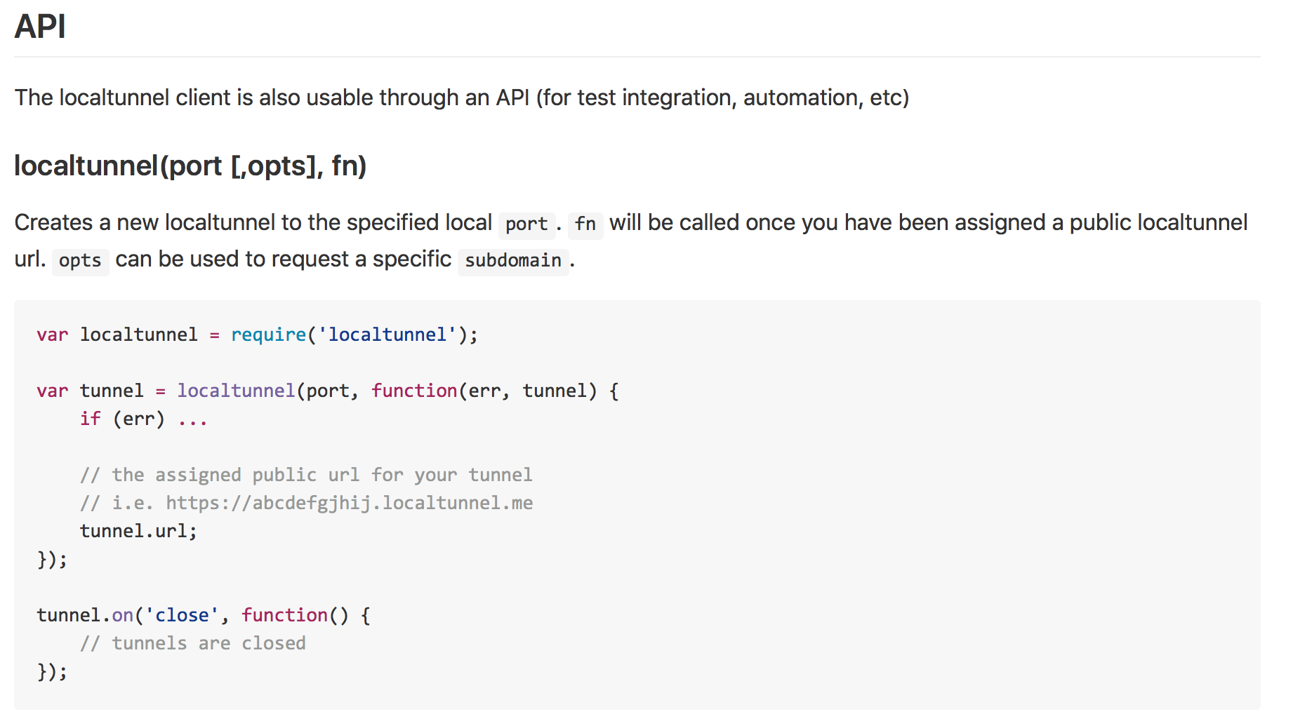
Notes:
And if you want to automate this further, you can use the localtunnel API so that you can script this setup. (Show this: https://github.com/localtunnel/localtunnel#api)

Slide 15
ngrok
Secure tunnel to your local machine
1. Sign up
2. Install ngrok
3. Install authtoken
4. Start your app
5. ./ngrok http 80
Notes:
Ngrok is another very popular option to consider. Like localtunnel, ngrok punches a hole in your firewall so your local machine can operate as a webserver. It offers some additional features over localtunnel, but requires some additional setup to support the extra power. With localtunnel you simply install an npm package and you’re rolling. With ngork, you have to sign up, download, install the app, and install an auth token. None of this is a big deal, but it is extra up front friction.
Ngrok’s advantage over localhost is security. You can password protect access. With localtunnel, anyone who can guess your URL can access your app while your localtunnel is open. But the advantage of localtunnel is it’s lower friction to set up since, unlike ngrok, you don’t have to perform all these steps to get rolling.

Slide 16
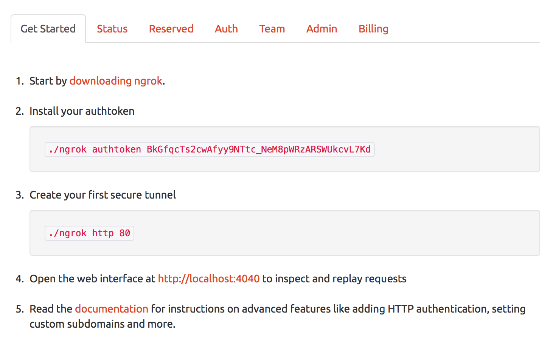

Slide 17
Vercel
Quickly deploy Node.js to the cloud
1. npm install -g vercel
2. Create start script
3. vercel
Notes:
Vercel is another low friction way to get your project up to the cloud so others can review it. Any directory that contains a package.json can be uploaded to the cloud using one command: Vercel.
Each time you deploy to Vercel, you’re assigned a new unique URL. And you can also use Vercel for your real production deployment if desired.
To use Vercel, you install it globally
And create a start script that opens your preferred web server such as express.
Then, anytime you want to deploy the app, you type vercel.
So vercel is a useful service if you’re building a Node.js application and want a low friction way to host it in the cloud. But since vercel publishes actual files to a public webserver, it’s a more permanent solution than ngrok or localtunnel. You don’t need to keep your machine on for people to see your work in progress.

Slide 18
Surge
Quickly host static files to public URL
Setup:
1. npm install -g surge
2. surge
Notes:
Another similar service is Surge. Surge assumes your app is just static HTML, JavaScript and CSS files. So the downside of surge is it only supports static files. But the upside is extreme simplicity. You don’t have to punch a whole in your firewall to expose your work. Instead, you quickly move your static files up onto their public webserver. Surge publishes your static files to their service and it then serves them at a public URL. The process for getting started couldn’t be simpler.
First, install surge globally.
Then, type surge in your project directory. The first time you run Surge, you’ll be prompted to provide an email and password on the command line. Otherwise, it will list your existing login and confirm the path that you’d like to serve. When you hit enter to accept the randomly generated URL, it will upload your app and expose it on the URL listed. Easy as that! And if you want to use surge as a more permanent host, you can even use your own domain name. So with that approach, surge becomes an easy way to do automated deployments via the command line.

Slide 19
Sharing Work-in-progress
localtunnel
ngrok
Vercel
Surge
Easiest setup
Ultra-versatile
Easy setup
Secure
No firewall hole
Hosting persists
No firewall hole
Hosting persists
Notes:
So bottom-line, all these tools are handy and offer different advantages and constraints.
If you’re looking for the lowest friction way to share your work and have no big security concerns, localtunnel is the easiest approach. It also works nicely with browsersync and supports exposing any work on your local machine, regardless of platform.
Ngrok offers a similar approach, that’s still straightforward, but a requires more initial setup work. In exchange, it offers more security by providing the ability to lock down access behind a login.
Finally, surge and now take a fundamentally different approach by not punching a hole in your firewall at all. Instead, they push your static files up to their server. Both are quite easy to set up, but since your files are hosted on a public server, your local dev machine isn’t a dependency. This means your hosting persists like traditional hosted solutions. You don’t have to keep your dev machine online to assure people can see your work. The downside for surge is it is only for hosting static files, whereas Vercel also supports Node.js projects.
Of course, another approach you can consider is just using traditional hosting for a user acceptance environment, but these are 4 low-friction and free options worth considering.

Slide 20
Share Work-in-progress via localtunnel
Notes:
Let’s try localtunnel to see how easy it is to share our work in progress.

Slide 21
Development Webservers
http-server
Express
Webpack dev server
Browsersync
Ways to share work-in-progress
localtunnel, ngrok, Vercel, Surge
Next up: Automation
Wrap Up
Notes:
In this module we considered a variety of development webservers including ultra-lightweight options like http-server, more full-featured options like Express, bundler specific options like Webpack dev server, and the amazing Browsersync which integrates with various options like Webpack dev server and Express.
We also saw many low-friction and free ways to share our work-in-progress on the public web. We used localhost since it offers an ultra-low friction way to share our work, but ngrok, Vercel and Surge are all great options for quickly sharing work. And depending on your needs, ngrok and surge are both potential options for production hosting as well.
Our development environment is coming along nicely. Now it’s time to begin automating tasks, so in the next module let’s explore popular options for task automation.

